Slide 1




Pituitary Volume and Glucocorticoid Receptor Genotype Contribute to the Development of Callous-Unemotional Traits
Andrew Dismukes, Elizabeth Shirtcliff, Sarah Whittle, Nicholas Allen, Michelle Byrne, Julian Simmons

Slide 2
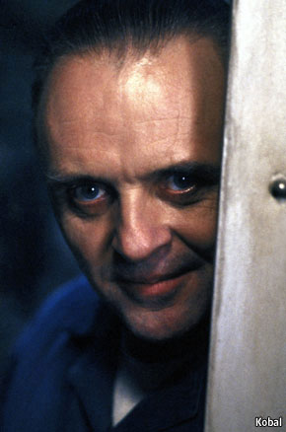

CU Traits
Lack of guilt or remorse
Lack of concern for feelings of others
Reduced impulse control
Lack of concern for important activities
Associated with increased delinquency
Aggressiveness
Considered intractable and treatment strategies are lacking
Frick, P.J., et al., Annual Research Review: A developmental psychopathology approach to understanding callous‐unemotional traits in children and adolescents with serious conduct problems. Journal of child Psychology and Psychiatry, 2014. 55(6): p. 532-548.

Slide 3
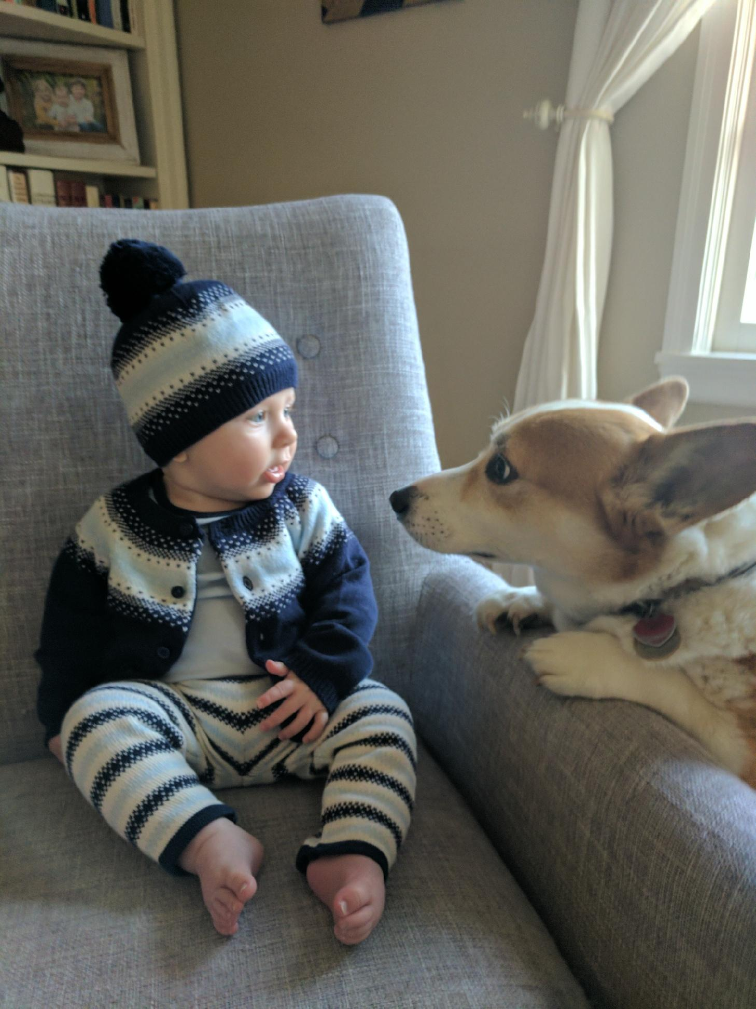
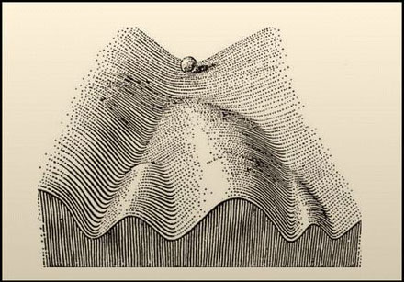
Etiology
Biological Processes
Health & Behavior
Experience

Slide 4
Genotype
DNA Methylation
RNA Expression
Histone Modifications
Proteins
Genetics
Expressome
Epigenetics
Physio Correlates
Behaviors
Cortisol
RSA
Immune
Internalizing
Externalizing
Time
Environment
Notes:
Orientation
Getting a sense of the big picture
Put what is going on in context
Technically the path to cortisol should flow through proteins but I cant make my bendy arrows bend that much.

Slide 5
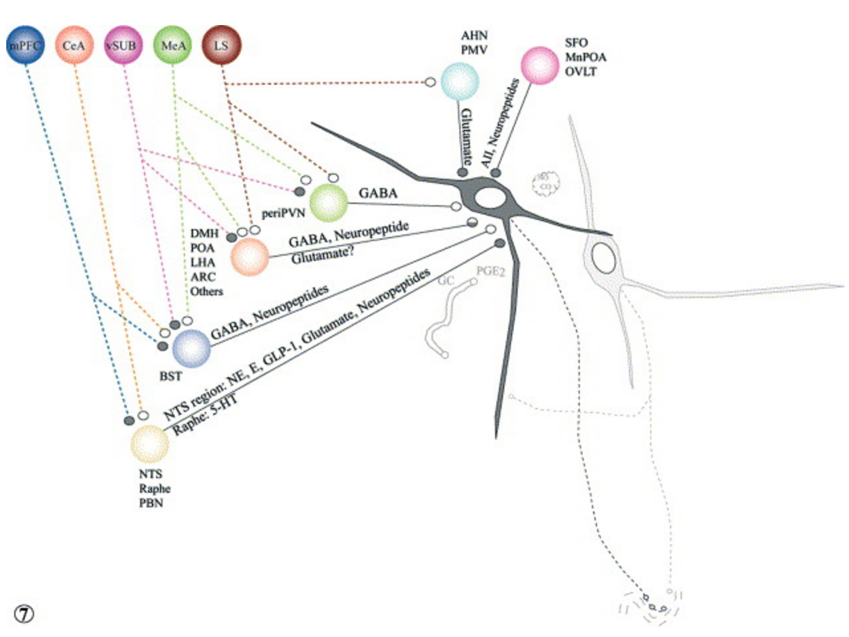
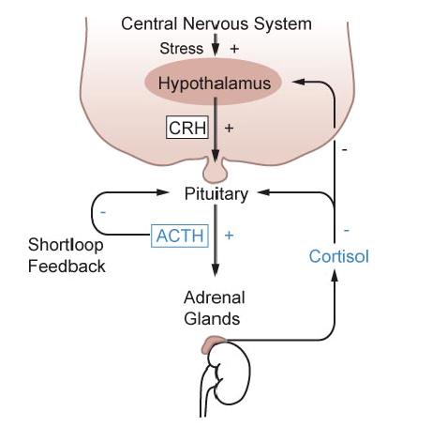

Slide 6
The ADS Study: An Overview
 | Phase 1 (T1) N = ~243 | Phase 2 (T2) N = ~212 | Phase 3 (T3) N = ~208 | Phase 4 (T4) N = ~163
Age | M age 12.6 | M age 15.2 | M age 16.4 | M age 18.8
Physiological Assessment | MRI, Neuropsych & Psychophys | Bio Samples (age 15.9, N=88) | MRI & Neuropsych | MRI & Neuropsych
Questionairres |  | APSD & CTQ |  | APSD
Other Measures | Family Interactions

Slide 7
What we can learn from ADS
In ADS:
Early Life Experience
CTQ
Maternal Aggression
Maternal Dysphoria
In ADS:
Physiological
Variables
Cortisol (Waking, Diurnal)
Genotype (BCL1)
Longitudinal Pituitary Volume
In ADS:
Behavioral Outcomes
Longitudinal APSD

Slide 8
CU IN ADS
Pituitary Volume
Biological Processes
Health & Behavior
Experience
Early Experience
CU Traits
GR Genotype
Gender

Slide 9
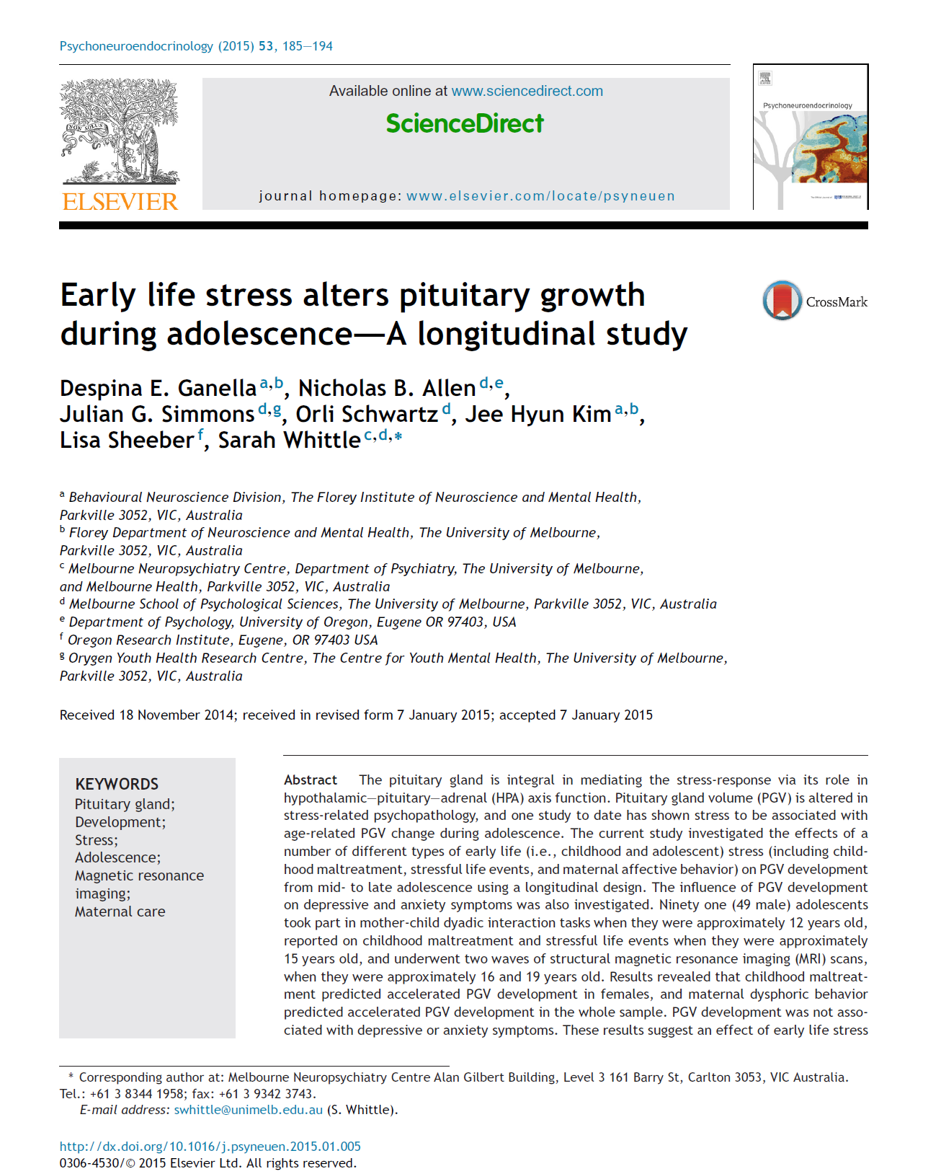
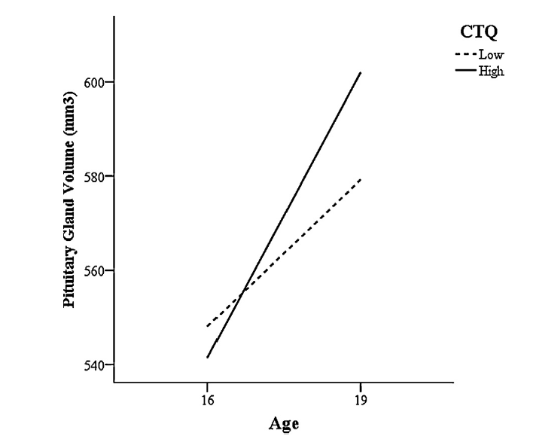
Pituitary Volume
Early Experience
CU Traits
GR Genotype
Gender

Slide 10
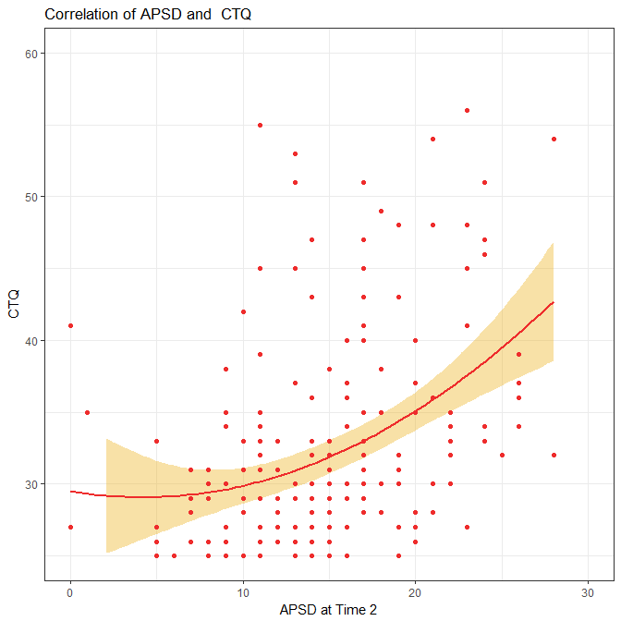
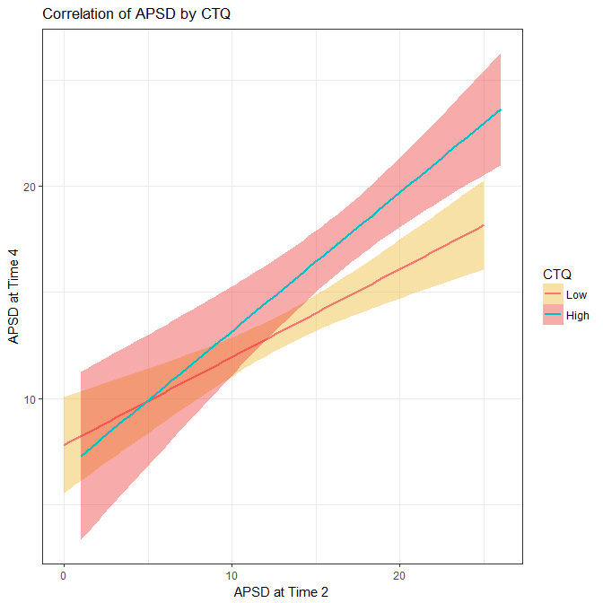
Biological Processes
Health & Behavior
Experience
Pituitary Volume
APSD Outcome | CTQ Total | Sex | Age
Wave 2 APSD Callous | .071*** | .47 | -.46
Wave 4 APSD Callous | .03 | .213 | .220
Wave 2 APSD Total | .293*** | .556 | -.864
Wave 4 APSD Total | .203*** | .874 | -.571
Wave 2 APSD Narcissism | .081*** | .143 | -.210
Wave 4 APSD Narcissism | .061** | .380 | -.202
Wave 2 APSD Impersonal | .120*** | -.111 | -.177
Wave 4 APSD Impersonal | .093*** | .574 | -.483
Early Experience
CU Traits
GR Genotype
Gender

Slide 11
Biological Processes
Health & Behavior
Experience
Pituitary Volume
APSD Outcome | Pituitary Volume | Sex | Age
Wave 2 APSD Callous | T2 MRI -.62** | -.18 | .04
Wave 2 APSD Total | T2 MRI -1.5** | -.61 | -.25
Wave 2 APSD Narcissism | T2 MRI -.51* | -.29 | .01
Early Experience
CU Traits
GR Genotype
Gender

Slide 12
Biological Processes
Health & Behavior
Experience
CC Genotype
APSD Outcome | Abuse Factor | Sex | Age
Wave 2 APSD Total | 2.23* | -.66 | -.87
CG_GG Genotype
Wave 2 APSD Total | 3.05*** | .925 | -.768
Pituitary Volume
Early Experience
CU Traits
GR Genotype
Gender

Slide 13
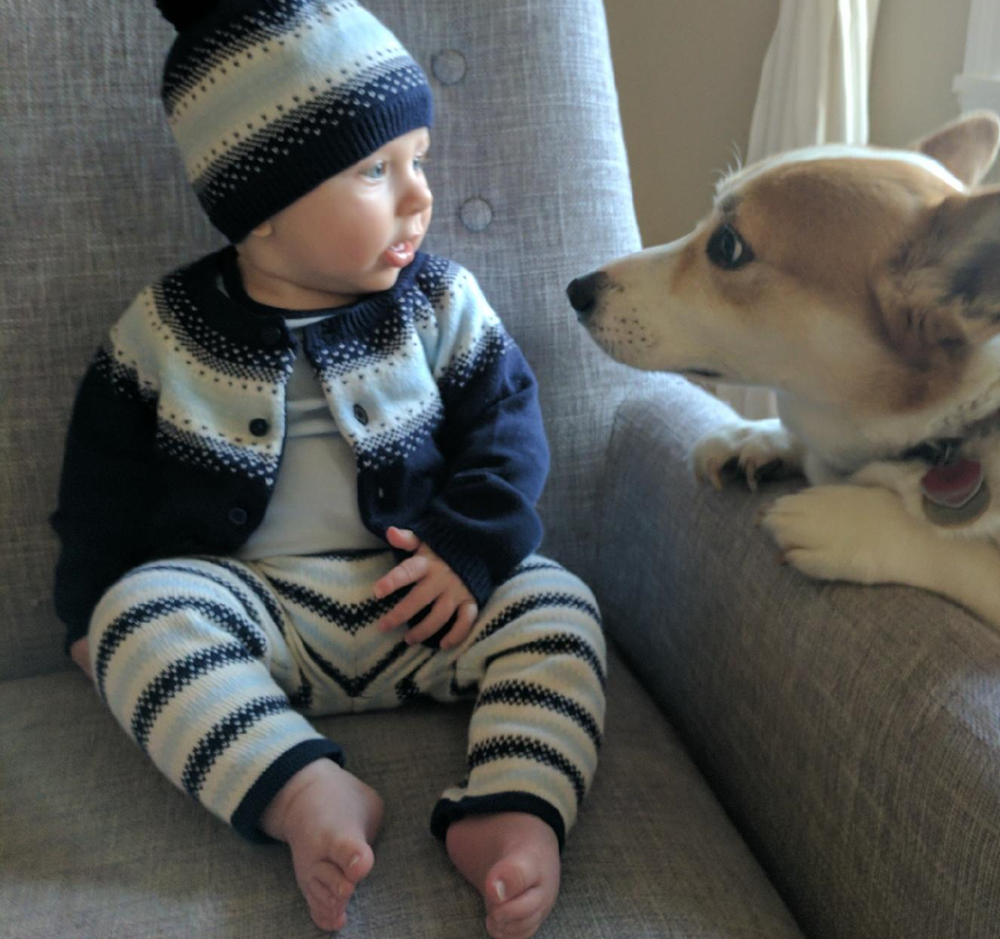
Conclusions
Experiences matter for CU beyond high risk populations
Cortisol is informed by a network of underlying processes.
Trajectory of CU is a conversation between biology and the environment, which can inform treatment strategies and timing.

Slide 14
Acknowledgements
Especially: The participants of the Adolescent Development Study who made this possible
The ADS core team, and especially Julian Simmons.
The Stress Physiology Lab at Iowa State University

Slide 15
Pituitary Volume
Early Experience
CU Traits
GR Genotype
Gender

Slide 16




Reactive DHEA(s) is Associated with Callous-Unemotional Traits in Institutionalized Youth
Andrew Dismukes, Stacy drury, Elizabeth Shirtcliff, Kathryn Humphries, Charles nelson, Nathan fox, Charles zeanah

Slide 17
CU Traits
Lack of guilt or remorse
Lack of concern for feelings of others
Reduced impulse control
Lack of concern for important activities
Associated with increased delinquency
Aggressiveness
Considered intractable and treatment strategies are lacking
Frick, P.J., et al., Annual Research Review: A developmental psychopathology approach to understanding callous‐unemotional traits in children and adolescents with serious conduct problems. Journal of child Psychology and Psychiatry, 2014. 55(6): p. 532-548.

Slide 18
Approach
Biological Processes
Health & Behavior
Experience

Slide 19
Genotype
DNA Methylation
RNA Expression
Histone Modifications
Proteins
Genetics
Expressome
Epigenetics
Physio Correlates
Behaviors
Hormones
Autonomic Measures
Immune
Internalizing
Externalizing
Time
Environment

Slide 20
Guiding Principles of the BEIP
Experience is the product of an ongoing, reciprocal interaction between the environment and the brain.
Individuality is the product of both personal experience and biological inheritance.

Slide 21
Sf Maria
Bucharest Early
Intervention Project
Sf Vasile
Controceni
Sf Andrei
Giulesti
Sf Ecaterina
136 Institutionalized
Children (6-30 months)
Never
Institutionalized
Group
NIG
n=72
Care As Usual
n=68
Foster Care
n=68
Assessments at 30, 42, 54 months
Follow-ups at 8, 12, and 16 years
Notes:
So, what did we actually do? In 2000, three scientists (Charles Nelson, Nathan Fox, and Charles Zeanah), with funding from the MacArthur Foundation, set about conducting a randomized controlled trial of foster care for institutionalized children in Bucharest, Romania.
The BEIP was the first ever randomized controlled trial of foster care as an alternative to institutional care. Children were recruited from 6 Bucharest institutions, and after a careful assessment of children’s functioning in the institutional setting, were randomized either into the high quality foster care or to the care as usual condition (typically remaining in care). The study had a noninterference policy, such that all placement decisions were made by the Romanian authorities and no child was required to remain in institutional care for the study. The value of the RCT design, which consists of random assignment into the two groups, means that any differences between the groups can be attributed as being caused by the intervention.
PRESS In addition, we also included a never institutionalized community comparison group. The study included assessments at baseline, age 30, 42, and 54 months, at which point the formal intervention ended. Follow ups were conducted at age 8 and 12 years, and we have begun the 16 year assessment.

Slide 22
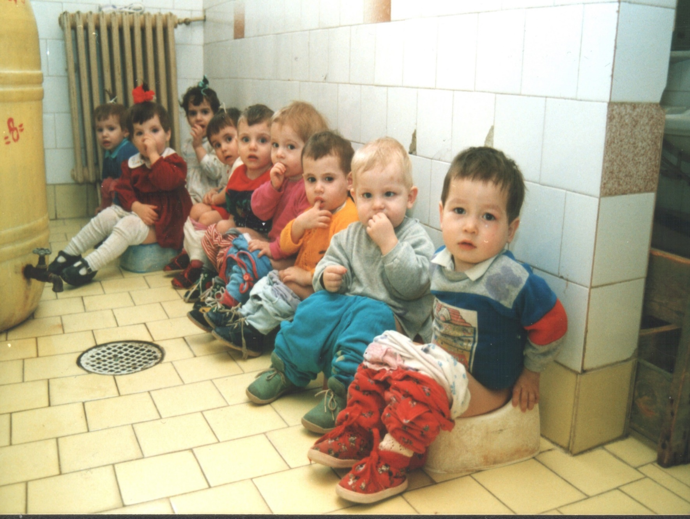
Institutional Care
Notes:
Institutional care is highly regimented, with high child to caregiver ratios. Here you see that all of the children in this group were taken to the bathroom at the same time, which illustrates that individual needs are often missed in trying to care for a large number of children at one time. The caregivers in institutions have a difficult job, and there are many caregiver changes throughout a child’s day.

Slide 23
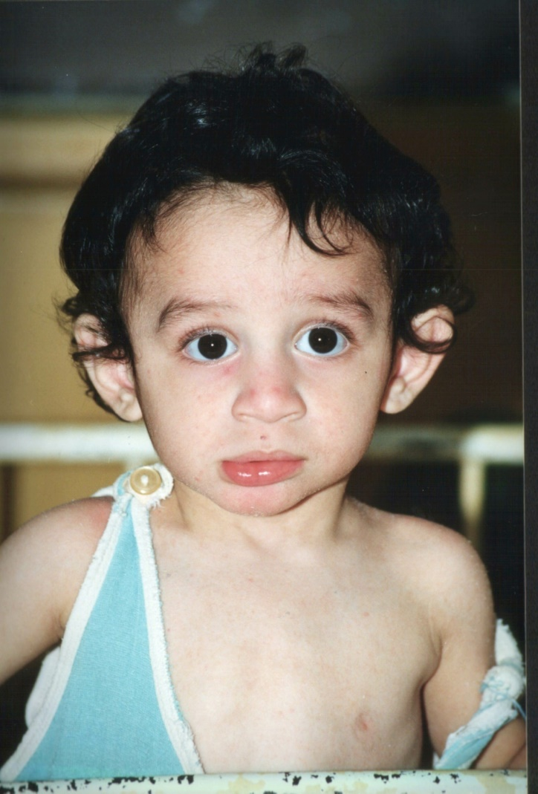
Children Reared in Institutions
Children raised in institutions are at dramatically increased risk for a variety of developmental problems:
Growth delays
Disturbances of social relatedness and attachment
Psychopathology
Deficits in IQ and executive functions
Language delays
Motor abnormalities
These problems believed to result from deprivation inherent in institutional care

Slide 24
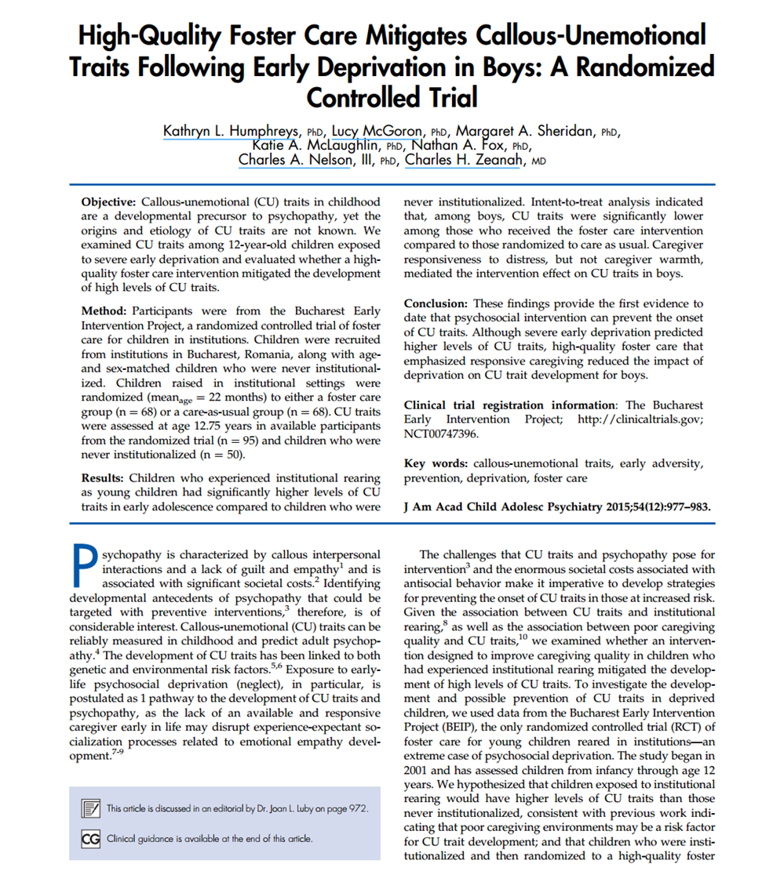
CU in BEIP
Notes:
. This pattern was also found using the CU cutoff, such that the intervention was a significant predictor of low CU traits among boys (Wald c2 [1] ¼ 4.62, p ¼ .028). For a CAUG boy, the odds of being above the CU cutoff were 10.82 times larger than the odds of an FCG boy being above the cutoff (95% CI ¼ 1.23–94.92).

Slide 25
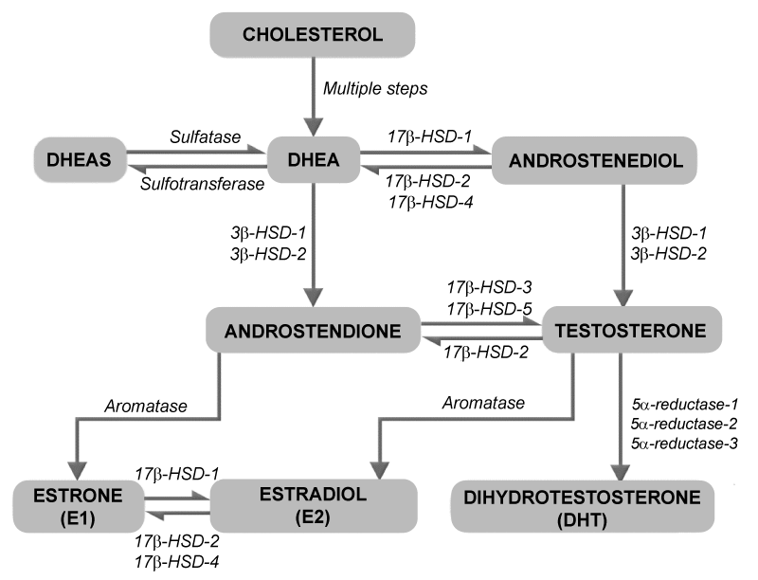
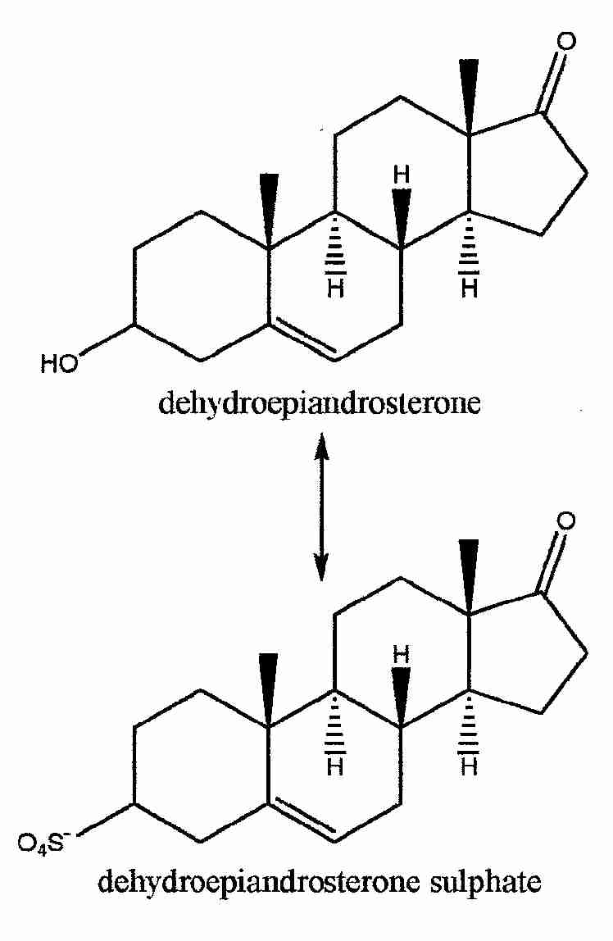
DHEA

Slide 26


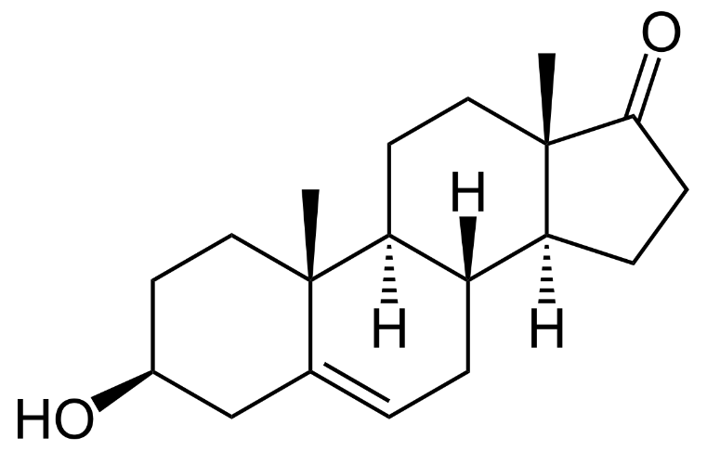
DHEA

Slide 27
DHEA – Paradoxical effects?
TESTOSTERONE – The hormone of aggression?
“…the sublingual administration of a single dose of testosterone in women causes a substantial increase in fair bargaining behaviour, thereby reducing bargaining conflicts and increasing the efficiency of social interactions.”
(Eisenegger et al., 2010)
OXYTOCIN – The Love Hormone?
Increased maternal aggression during maternal defense test
(Bosch et al., 2005)
Increased envy and gloating
(Shamay-Tsoory et al., 2009)
CORTISOL
Toxic Stress vs Adaptive Calibration
Elevated plasma DHEAs associated with conduct disorder
(Van Goozen et al. , 1998)
Elevated circulating DHEAs associated with ODD relative to clinical and psychiatric controls
(Van Goozen et al., 2000)

Slide 28
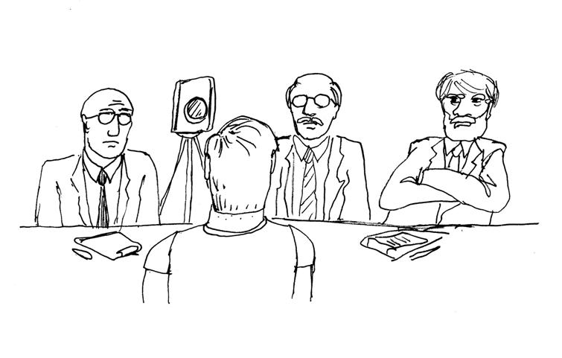
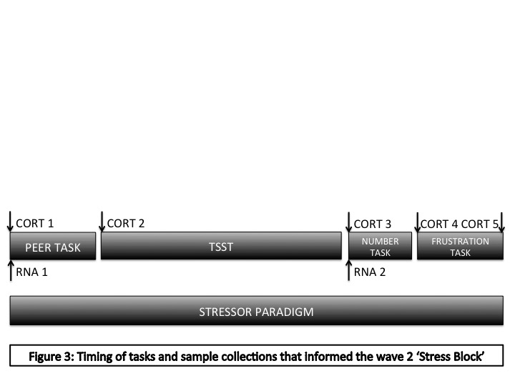
Task Timing

Slide 29
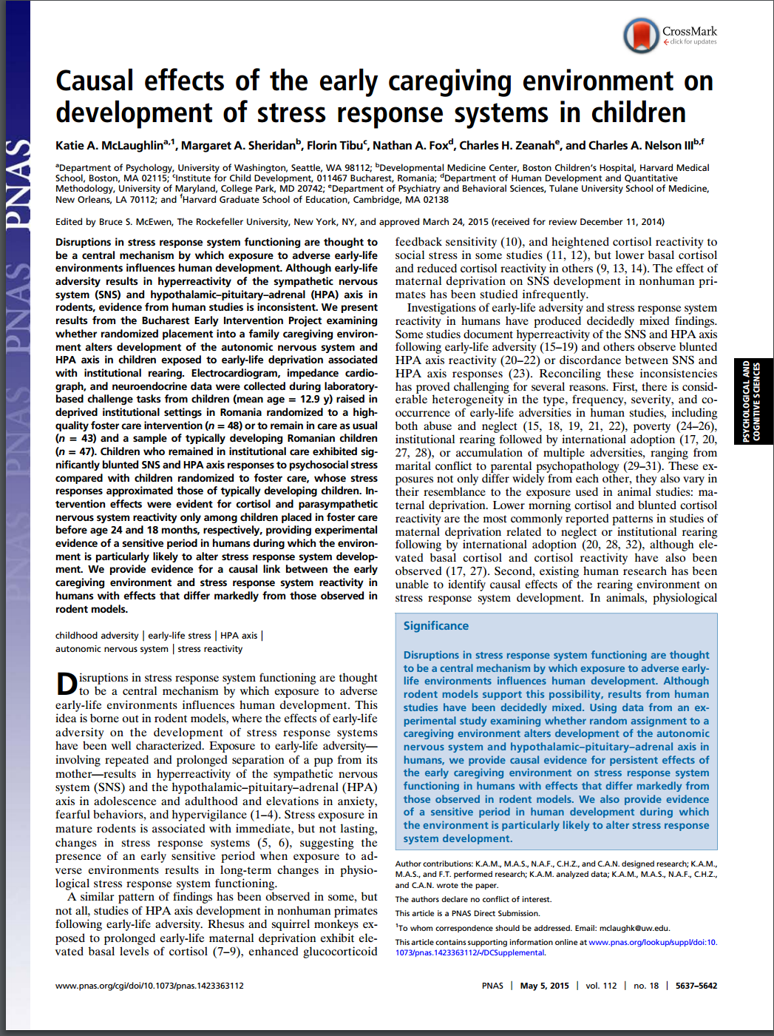
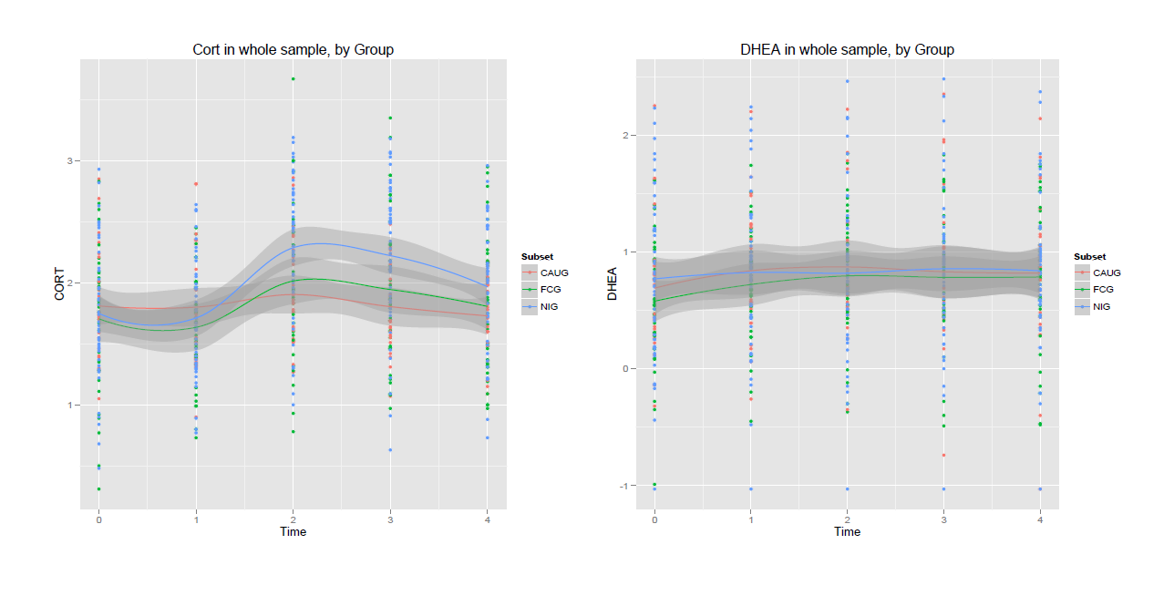
Group Differences in Cortisol and DHEA

Slide 30
Analytical Strategy
Multilevel models of Hormone predicted by time
Cross level interaction of ICU
Controlling for:
BMI, Ethnicity, Treatment Status, Puberty Status

Slide 31
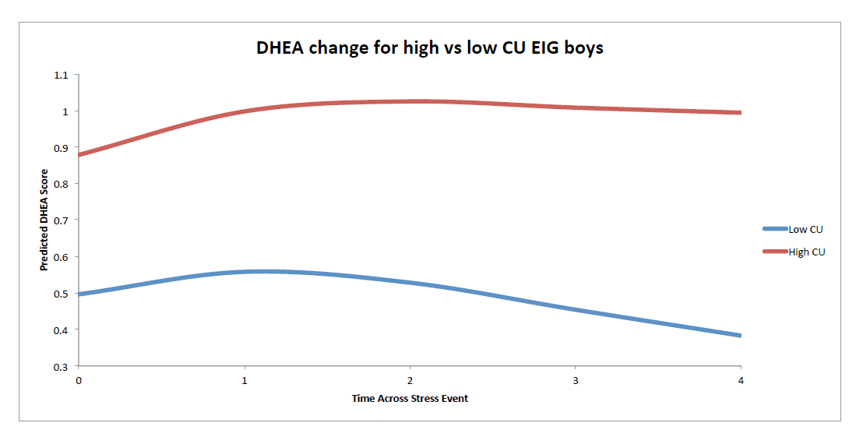
DHEA and CU Traits in EIG Boys

Slide 32
Sex differences

Slide 33
Conclusions
Biological Processes
Health & Behavior
Experience
Sex differences
No treatment effect
Limitations
Sample Size
Other androgens

Slide 34
Principal Investigators
Charles A. Nelson, Boston Children’s Hospital/Harvard University
Nathan A. Fox, University of Maryland
Charles H. Zeanah, Tulane University School of Medicine
Tulane Collaborators
Current
Previous
Stacy Drury
Mary Margaret Gleason
Devi Miron
Kathryn Mascowitz
Anna T. Smyke
Valerie Wajda Johnston
Julie Larrieu
Administration/Management
Elizabeth Furtado
Leanna Papp
Romanian Research Team
Alexandra Cercel, Iuliana Dobre, Marianna Mitu, Carmen Pascu,
Marcela Pobereznicenco, Anca Radulescu, Nadia Radu, Florin Tibu
Funding Sources
John D. and Catherine T. MacArthur Foundation; National Institute Mental Health
Notes:
I would like to thank in particular the study’s three principal investigators, especially my postdoctoral advisor Dr. Zeanah. I also want to acknowledge my collaborators at Tulane, and the research team and support staff for BEIP.

Slide 35

